Slide 1
Mine Detection Robot
Project ID:- 37
Project Group Members:
1) Darshit Rai (17u481, 422013)
2) Harjyot Sethi (17u629, 422019 )
3) Jigar Sonigara (17u624, 422021)
4) Mustafa Jwadwala (17u577, 421037)
Project Guide : Prof. Yogesh Sharma

Slide 2
OUTLINE :
ABSTRACT
INTRODUCTION
PROBLEM STATEMENT
NEED OF PROJECT
OBLECTIVE AND SCOPE OF PROJECT
LITERATURE SURVEY
BLOCK DIAGRAM

Slide 3
FLOW CHART
METHODOLOGY
HARDWARE AND SOFTWARE SPECIFICATIONS
CONTRIBUTION OF THE PROJECT
APPLICATIONS
WORK DONE TILL DATE
EXPECTED CONCLUSIONS
REFERENCES

Slide 4
ABSTRACT:
The intention of this system is to reduce human victims in terrorist attack such as 26/11 . So this problem can be overcome by designing the RF based spy robot which involves wireless camera, So that from this it will be easy to examine rivals when it required.
This robot can quietly enter into enemy area and sends us the information via wireless camera. Mobile robotics play an increasingly important role in military matters, from patrol to dealing with potential explosives. “With suitable sensors and cameras to perform different missions, mobile robots are operated remotely for reconnaissance patrol and relay back video images to an operator.
Here we will be designing a robot that can be controlled using an application running on an android phone.

Slide 5
INTRODUCTION:
Now-a-days tracing and attacking enemies at different areas are very much difficult for the soldiers. There is always a chance for loss of lives of the soldiers during war and emergency situations
We are implementing a solution for the problem of replacing a soldier with a Robot Soldier completely controlled with a wireless network.
The whole system is controlled via android application.
The Wi-Fi device and microcontroller which will receive commands sends by the android application.
The system sends commands to the receiving circuit mounted on the vehicle through android application.

Slide 6
The android application involves commands like forward, backward, right and left direction to control the robotic arm.
Thus this application involves both Robotic arm and Robotic vehicle so that the system can not only be used to enter a high risk area but also to pick, move and place whichever objects it wants to.
Each and every movement of the vehicle will be recorded and can be viewed in a PC wirelessly.
We can make use of advanced controller in controlling the operation of robot. It can have many uses in practical fields.
This system can be helpful in wars as a part of spying.

Slide 7
PROBLEM STATEMENT:
To design a mine detection robot using different sensors for different controlling actions such as spying, bomb detection, etc.

Slide 8
NEED OF PROJECT:
The existing robots are whole operated with the help of remote control. This operation is sometimes tedious, less efficient and has no guarantee for its security. The existing system consists of trade-off between processing speed, insecure communication and cost.
In this system bomb disposal missions provide arm or designers, disposal technicians and mission controllers with a number of challenges including high risks in it.
With growing trends, controllers are developing tremendously. Hence we can make use of advanced controller in controlling the operation of robot.

Slide 9
OBJECTIVE AND SCOPE OF THE PROJECT:
Military robots are autonomous or remote controlled devices or robots designed for military applications.
Robots could reduce the number of military personnel injured or killed in combat situations.
It can be built further to work as a HUMANOID.
It can be use for search & rescue type operations and also in bomb defusing.
It is also use this robot for animal tracking in forest.
It can be use for pick up injured soldier from war station and dropping them in safe place.
It can carry extra material like as bombs, missiles, blankets etc.

Slide 10
It can have many uses in practical fields from teenager’s robots to robots working in industries.
It is helpful in wars as a part of spying.
The proposed robot can be further improved in terms of decision taking capabilities by employing varied types of sensors and thus could be used in big industries for different applications.

Slide 11
LITERATURE SURVEY:
Sr.No. | Title of the Paper/Article | Author / Year of Publication | Methodology Used | Conclusion
1 | War Field Spying Robot with Wireless Camera | Priyanka Yadav, Leena Chaudhari, Swati Gawhale BharatiVidyapeeth College of Engineering, Lavale, India 2017 | Using night vision camera and monitoring using RFID. | Currently Wireless controlled Omni-directional monitoring robot with video support that can monitor using webcam. As per the present scenario, human dependencies on technology and future trends robots are going to be used as a perfect replacement for human being in all aspects of life.
2 | Arduino Controlled War Field Spy Robot using Night Vision Wireless Camera and Android Application | Jignesh Patoliya1, Haard Mehta2, Hitesh Patel, V. T. Patel Charotar University of Science and Technology, Changa, Anand, Gujarat,India 2015 | Architecture of bluetooth module HC-05 along with L293D motor driver IC.. | The model of robot can be described to build a robot using night vision wireless camera run by android application and the people can learn about developing android application in order to control the robot through wireless application using the platform of MIT app inventor.

Slide 12
4 | Smart Spy Robot | Ankit Yadav, Anshul Tiwari , Divya Sharma, Ratnesh Srivastava, Sachin Kumar, IMS Engineering College, Ghaziabad 2016 | Architecture of bluetooth module HC-05 and RFID technology | The robot will move depending on the motor direction. With the help of the camera we are able to view the things that are happening in the surrounding area where the robot is hidden.
5 | Military Spying and Bomb Disposal Robot Using IOT | Chaitrali Jadhav, Shamli Gibile, Snehal Gaikwad, Neelum Dave DIT, Pimpri 2018 | Android phone will connect to the server using TCP/IP link. | Due to the less and rare technology available for bomb disposal operation the demand for wireless technology used for military spying and bomb disposal purpose is very beneficial.
6 | Multi Purpose Military Service Robot | E Amareswar, G Shiva Sai Kumar Goud, K R Maheshwari, E Akhil, S Aashraya, T Naveen, MLR Institute of Technology Hyderabad, India 2017 | An Android smart phone will act as remote controlled device for movement of the robot. An Android application will be developed for the same. The application will support only the2.2 and above versions of Android Operating System.. | This program uses Bluetooth connection to communicate with robot. It has proven to allow for meaningful two-way communication between the Android phone and the robot The Multi-Purpose Military Service Robot has been designed in such a way that it can fulfill the needs of the military, the police and armed forces.

Slide 13
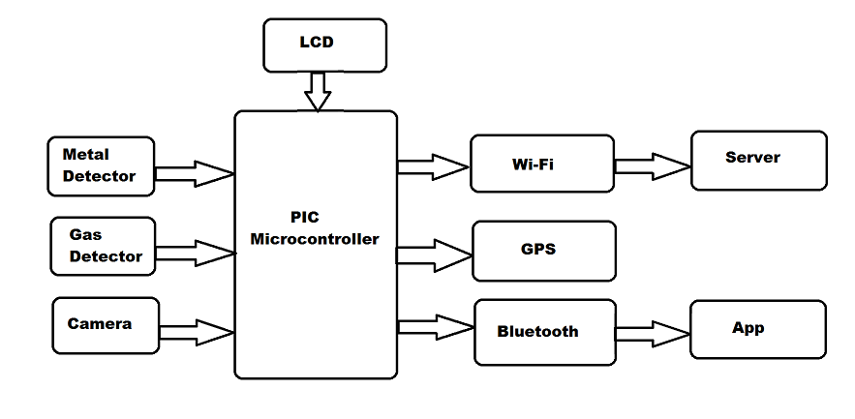
BLOCK DIAGRAM:
Fig.1.Block diagram of system

Slide 14
BLOCK DIAGRAM EXPLANATION:
PIC16F877A: The microcontroller controls all the system. It is used to interface various sensors, LCD, Wi-Fi,etc.
POWER SUPPLY: It is used to supply power to the system.
METAL DETECTOR: It is use to detect metal object and send message to the controller. It is specially used for bomb detection.
WI-FI,BLUETOOTH,GPS: These are used as a medium between controller and servers.
SERVER,APP: These are used to controller the motion of the robot and also used to check the detail given by the detectors and camera.

Slide 15
HARDWARE SPECIFICATION:
Android smart phone
Bluetooth module
The bluetooth module HC-05 consists of six pins. The six pins Key,5V,GND,Tx,Rx,Status. The bluetooth module has two devices.1) master device 2) slave device.
DC power supply
12V and 5V dc supply will be used.
Motor Driver
The L293 and L293D are quadruple high-current half-H drivers. The L293D is designed to provide bidirectional drive currents of up to 600-mA at voltages from 4.5V to36V. The L293D IC has sixteen pins. There are four input pins and four ground pins. Two motors are connected between the four output pins.

Slide 16
Microcontroller:
One PIC16F877A microcontroller is used to operate the function of the robots.The microcontroller controls all the system.
PARAMETERS | VALUES
Operating speed | DC – 20 MHz clock input DC – 200 ns instruction cycle
Flash Program Memory | Upto 8K x 14 words
Data Memory (RAM) | Upto 368 x 8 bytes
EEPROM Data Memory | Upto 256 x 8 bytes
Timer0 | 8-bit timer/counter with 8-bit prescaler
Timer1 | 16-bit timer/counter with prescaler, can be incremented during Sleep via external crystal/clock
Timer2 | 8-bit timer/counter with 8-bit period register, prescaler and postscaler

Slide 17
DC motors
The speed of step execution controls the rate of motor rotation. A 1.8° step motor executing steps at a speed of 200 steps per second will rotate at exactly 1 revolution per second. Stepper motors can be very accurately controlled in terms of how far and how fast they will rotate. The number of steps the motor executes is equal to the number of pulse commands it is given. A step motor will rotate a distance and at a rate that is proportional to the number and frequency of its pulse commands.

Slide 18
Metal Detector
Fully automatic self adjusting circuit.
Effectively detects minute quantities of gold, silver, platinum, brass, copper, mild & stainless steel.
Ultra-high sensitivity and stability.
Large scanning area.
Very quick & clear response to metal objects.
Visual indications for Power ON, Metal detection, Battery Low & Battery charging ON.
Smoke Detector
Height: 47mm(mounted in B401 base)
Diameter: 102mm
Weight: 105g

Slide 19
SOFTWARE SPECIFICATION:
Programming software: MPLAB
Simulation software: Proteus, Multisim
PCB designing software: Proteus, Express PCB

Slide 20
FLOW CHART:
Fig.2. Flow chart of system

Slide 21
ADVANTAGES AND APPLICATIONS :
1)The robot is small in size so can be used for detecting mines.
2) This robot can be used in the borders for disposing hidden land mines.
3) The robot can be used for surveillance or reconnaissance.
4) Military robots are autonomous or remote controlled devices or robots designed for military applications.
Robots could reduce the number of military personnel injured or killed in combat situations.
6)It can be use for search & rescue type operations.
7) In bomb defusing.
8) It is also use this robot for animal tracking in forest.
9) It can be use for pick up injured soldier from war station and dropping them in safe place. It can carry extra material like as bombs, missiles, blankets etc.

Slide 22
Formation of Groups
WORK DONE TILL DATE:
Finalizing Domain and Title of Project
Literature Survey
Formation of Synopsis and checked by Project Guide
Components Identification
Power Supply Simulation on Multisim Software
Study the Working Principle of Metal Sensor, L293D driver IC and PIC microcontroller
Working of Our Proposed System

Slide 23
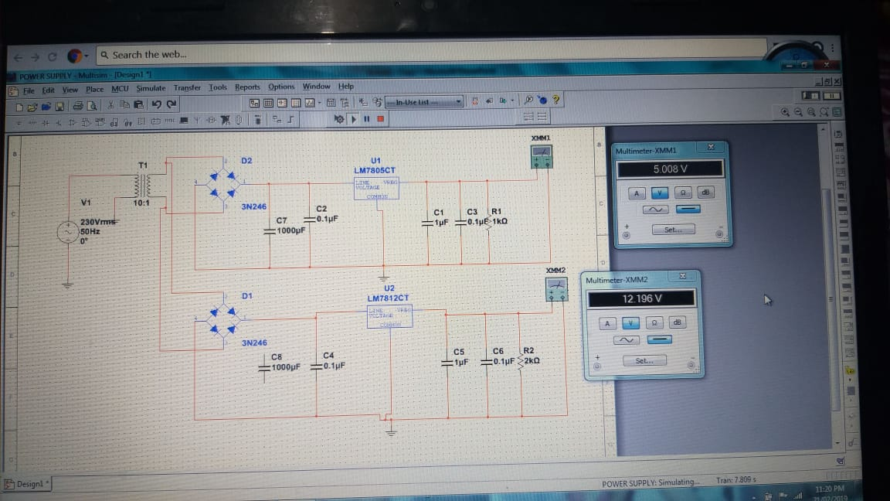
Simulation Result of Power Supply :

Slide 24
EXPECTED CONCLUSION:
Smart phone is android which can develop effective remote control program. At the same time, this program uses Bluetooth connection to communicate with robot. It has proven to allow for meaningful two-way communication between the Android phone and the robot The Multi-Purpose Military Service Robot will be designing in such a way that it can fulfill the needs of the military, the police and armed forces. It has countless applications and can be used in different environments and scenarios. For instance, at one place it can be used by the armed forces, military purposes, while at another instance it can be used for spy purposes.

Slide 25
[1] War Field Spying Robot with Wireless Night Vision
Camera International Journal for Research in Applied Science & Engineering Technology (IJRASET) ISSN: 2321-9653; IC Value: 45.98; SJ Impact Factor :6.887
Volume 5 Issue XII December 2017
Author: Priyanka Yadav, Leena Chaudhari, Swati Gawhale BharatiVidyapeeth College of Engineering, Lavale, India.
[2] Arduino Controlled War Field Spy Robot using Night Vision Wireless Camera and Android Application Conference Paper · November 2015 DOI:10.1109/NUICONE.2015.7449624
Author: Jignesh Patoliya1, Haard Mehta2, Hitesh Patel, V. T. Patel Charotar University of Science and Technology, Changa, Anand, Gujarat,India.
[3] Smart Spy Robot ISSN: 2278 – 7798 International Journal of Science, Engineering and Technology Research (IJSETR) Volume 5, Issue 4, April 2016 973 All Rights Reserved © 2016 IJSETR.
Author: Ankit Yadav, Anshul Tiwari , Divya Sharma, Ratnesh Srivastava, Sachin Kumar,
IMS Engineering College, Ghaziabad
REFERENCES:

Slide 26
REFERENCES:
[4] Military Spying and Bomb Disposal Robot Using IOT. International Research Journal of Engineering and Technology (IRJET) e-ISSN: 2395-0056 Volume: 05 Issue: 04 | Apr-2018 www.irjet.net p-ISSN: 2395-0072.
Author: Chaitrali Jadhav, Shamli Gibile, Snehal Gaikwad, Neelum Dave DIT, Pimpri
[5] Multi Purpose Military Service Robot. International Conference on Electronics, Communication and Aerospace Technology ICECA 2017.
Author: E Amareswar, G Shiva Sai Kumar Goud, K R Maheshwari, E Akhil, S Aashraya, T Naveen, MLR Institute of Technology Hyderabad, India

Slide 27
THANKYOU

